Slide 1
Exercises on OOP and Code Organization
Using OOP to Solve Complex Problems

Slide 2
Announcement: Judge Assignment 2 is Coming!
Contest starts Monday, 17th April 2017, 10:00
Ends on Sunday, 30th April 2017, 23:59
After contest end, a practice option will be available (practice doesn't count towards your result for the course)
After contest end, solutions and tests for the problems will be published
You will be provided with a link to the contest
Contest will probably require submitting .h and .cpp files
Unlike the previous Judge Assignment where you only copy-pasted code into the system

Slide 3
Table of Contents
Inheriting from the Standard Library
Examples of Multiple Inheritance and virtual Inheritance
Writing a Linked List
Creating a Simple Game

Slide 4
Inheriting from the Standard Library
Let's Extend std::string

Slide 5
Inheriting from the Standard Library
We want a class which can:
Count words in an std::string
Return the Nth word in a std::string
Change the Nth word in a std::string
Support the normal string operations and act as a normal std::string
We can do it by inheriting the std::string class
add methods for the extended logic
add operators to handle standard string operations (e.g. +, +=)
… or define an implicit conversion from string (i.e. a constructor that takes a string)

Slide 6
Deriving from std::string
Live Demo

Slide 7
Multiple Inheritance and virtual Inheritance
Handling Multiple Inheritance in C++

Slide 8
Multiple Inheritance
C++ classes can inherit multiple other classes
Each inherited class is basically inserted into the derived class
If class members conflict:
Internal code can use InheritedName::member to access a member
External code needs a cast to the respective base type

Slide 9
Multiple Inheritance – Example
class Animal {
float speed;
}
class Plant {
bool hasSeeds;
}
class GMO : Animal,Plant {
}
Animal
Plant
float speed
bool hasSeeds
GMO : Animal, Plant
Animal members
Plant members
float speed
bool hasSeeds

Slide 10
Multiple Inheritance
Live Demo

Slide 11
Multiple Inheritance – the Diamond Problem
Organism
float weight
class Organism {
float weight;
}
class Animal : Organism {
float speed;
}
class Plant : Organism {
bool hasSeeds;
}
class GMO : Animal,Plant {
// we get 2 copies of
// Organism here…
}
Animal : Organism
Plant : Organism
Organism
Organism
float weight
float weight
float speed
bool hasSeeds
GMO : Animal, Plant
Animal
Plant
Organism
Organism
float weight
float weight
float speed
bool hasSeeds

Slide 12
virtual Inheritance – handling the Diamond
Animal : virtual Organism
Plant : virtual Organism
Organism
Organism
class Organism {
float weight;
}
class Animal : virtual Organism {
float speed;
}
class Plant : virtual Organism {
bool hasSeeds;
}
class GMO : Animal,Plant {
// We get only 1 Organism here
// that Plant & Animal point to
// instead of having a copy
}
float weight
float weight
vtable * organism
vtable * organism
float speed
bool hasSeeds
GMO : Animal, Plant
Organism
float weight
Animal
Plant
vtable * organism
vtable * organism
NOTE: constructors for virtually inherited classes are only executed for the actual type – i.e. if we create a Plant, the Organism ctor will be executed, but if we create a GMO, the ctor will only be executed when GMOs constructor executes, NOT when Animal's and Plants ctors execute. So the GMO class must call the Organism ctor
float speed
bool hasSeeds

Slide 13
virtual Inheritance
Live Demo

Slide 14
Writing a Linked List
Utilizing OOP to Build a Data Structure

Slide 15
Writing a Linked List
Linked List data structure concept:
Contains a sequence of elements
Elements are NOT guaranteed to be in consecutive memory addresses (unlike arrays)
Each element points to the address of the next (and/or previous) element
Adding and removing happens instantly (if we know the element's address)
Finding an element requires traversing the list
What we need to have:
A class to represent elements with values and pointers to other elements
A class which represents the linked list (knows size, start & end element)

Slide 16
Writing a Linked List
Live Demo

Slide 17
Creating a Simple Game
Combining Classes, Inheritance, Polymorphism and Console Operations to Make a Working Game

Slide 18
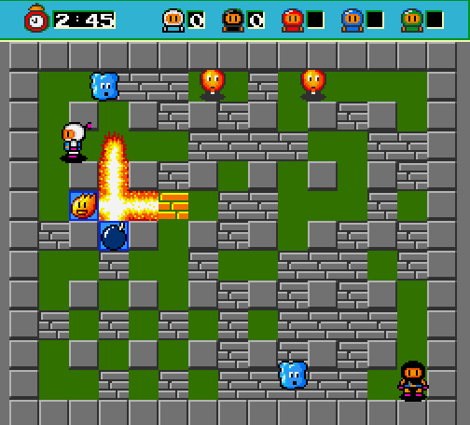
Writing Dyna Blaster – Console Version!
2-4 players playing at the same time in a square grid (a matrix)
Positions are integer coordinates in the grid
2 objects "collide" when they have the same grid coordinates
Players move at a speed of 1 grid unit per second
The game has wall-like objects:
Players can't pass through them (collide)
Indestructible & Destroyable walls
Players drop bombs, which explode after time
Bomb explosions go up, down, left and right, in the grid, for a certain length
Bombs destroy any destroyable objects, including players and the owner (when the explosion collides with a destroyable object)

Slide 19
Writing Dyna Blaster – Additional Features
There are "creeps" in the game
Non-playable, AI-controlled creatures, which kill the players on contact
2 types – Ghost and Blob. Ghosts can pass through destroyable walls
Can also be killed by bombs
The game also has power-ups
Can be picked-up by players to change some of their characteristics
Explosion range power-up – increases explosion range by 1 grid unit
Bombs power-up – increases the number of bombs a player can drop at a time (i.e. the number of non-exploded bombs dropped by a player)

Slide 20
Creating a Simple Game
Live Demo

Slide 21
Questions?

